Slide 1
Day 3: Text Analysis
Zoë Wilkinson Saldaña

Slide 2
Some (Overlapping) Definitions
Text analysis
“‘Text analysis’ is a broad term covering various processes by which text and natural language documents can be modified so that they can be organized and described.” (Duke LibGuide)
“...computational analysis of text is not a specific new technology or a subfield of digital humanities; it’s a wide-open conversation in the space between several different disciplines” (Underwood)

Slide 3
Some (Overlapping) Definitions
Text mining
“Text mining is a research practice that involves using computers to discover information in large amounts of unstructured text…. Examples of unstructured data used for text mining include journal and news articles, blog posts, and email.” (Illinois LibGuide)
Natural Language Processing
“Natural language processing combines the power of artificial intelligence with linguistics to process and analyze language-based data. NLP considers the building blocks of language as data and analyzes these data segments, looking for latent structures and patterns in language.” (Educause)

Slide 4
Early Questions to Consider
Preparing text data
Is your text structured or unstructured? (Hint: most text from primary sources is unstructured)
If unstructured, do you need to structure your data in some fashion before analysis?
Are there any extraneous elements of your text or mistakes that you may need to clean before analyzing your data? (Example: poor scanning quality, confounding data like “Digitized by Google”)

Slide 5
Early Questions to Consider
Relationship of language to your research questions
How might your text data permit you to infer knowledge, beliefs, assumptions, internal states, etc. from the presence of words and phrases? (This is the difficult and contested question at the heart of text analysis!)
If you are interested in affect and subjective states, can you reasonably assume that word choice/punctuation/etc. may correspond to positive/negative valence and/or specific emotions?

Slide 6
Early Questions to Consider
Unit of analysis
What is the size or scope of a single data point in your analysis? (Most common units: words or multi-word phrases [sometimes called n-grams])
Do any words or phrases refer to entities (such as locations, people, items) that may be of special importance to approaching you research question?
Would you like to infer the “meaning” being conveyed through casual speech? (In this case, you may be interested in parts of speech tagging and natural language processing methods).

Slide 7
Text Analysis as a Pipeline
Data sources
Structured text
Collection of entities /features
Outcomes of analysis
Text or table output, data visualization, appending to dataset, etc.

Slide 8
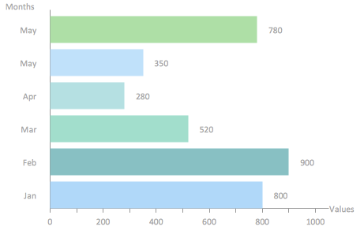
Think of Text Analysis as a Pipeline
Example: .csv file for each interview with name and statement columns; metadata file describing interviews
Example: .txt file of INTERVIEWER’s “stemmed words”:
what, is, the, hard, part, of, math, for, you
Example: .csv file for “math” collocates:
pointless, 12, 0.033
boring, 8, 0.011
problem, 7, 0.2000
failed, 6, 0,3155
Example: Interview transcripts as .docx files
Data sources
Structured text
Collection of entities /features
Outcomes of analysis
Text or table output, data visualization, appending to dataset, etc.

Slide 9
Think of Text Analysis as a Pipeline
Example: .csv file for each interview with name and statement columns; metadata file describing interviews
Example: .txt file of INTERVIEWER’s “stemmed words”:
what, is, the, hard, part, of, math, for, you
Example: .csv file for “math” collocates:
pointless, 12, 0.033
boring, 8, 0.011
problem, 7, 0.2000
failed, 6, 0,3155
Example: Interview transcripts as .docx files
Data sources
Structured text
Collection of entities /features
Outcomes of analysis
Text or table output, data visualization, appending to dataset, etc.
Data formatting
Data cleaning
Tokenization
Stemming
Normalizing (e.g. make undercase)
Entity recognition
Part of speech recognition
Concordances
Word/n-gram count
Collocates
Sentiment analysis
Topic modeling
Clustering
Classification
Data formatting (often portable data formats, e.g. .json, .csv)
Data visualization
Appending to other datasets

Slide 10
Today, we’re focusing on analysis of structured texts
Structured text
Collection of entities /features
Outcomes of analysis
Tokenization
Stemming
Normalizing (e.g. make undercase)
Entity recognition
Part of speech recognition
Concordances
Word/n-gram count
Collocates
Sentiment analysis
Topic modeling
Clustering
Classification

Slide 11
Part 1: Counting and (Non-ML) Probability Techniques

Slide 12
Concordances
Instances of a word or phrase within a text (or corpus of texts)
Concordances can be represented as a list (often with surrounding context as well) or also visually as a concordance plot.

Slide 13
Word/N-Gram Count
An n-gram is a sequence of n length of parts of speech or text. Often the unit of analysis is a word.
The concept of an n-gram thus encompasses an individual word, or uni-gram. Two word phrases are bi-grams, three word phrases are tri-grams, and so on.

Slide 14
Collocates
Collocation is the concept of words that occur near a given word at a higher frequency than we would expect from a totally random distribution.
When looking only at the words immediately before or after a target word, collocates may reveal common phrases (similar to a bi-gram).
When looking at a broader window (such as five words before through five words after a target word), collocates can reveal the context of a given word, which may imply something about the meaning, associations, and related ideas to a concept.

Slide 15
Collocates
The measure of “more frequently than expected by a random distribution” can be calculated several ways:
T-score: Our confidence that the rate of co-occurrence is significantly higher than random
Mutual information: A calculation of the mutual dependence of two variables (if you know something about one, how likely do you know something about the other).
MI may perform better with low-frequency associations (words that already appear infrequently in the corpus) vs high-frequency, which t-score may be better suited to detect. (More on this.)

Slide 16
AntConc!

Slide 17
AntConc
Introduction video with directions for exploring the Sherlock Holmes text corpus

Slide 18
Part 2: Complex Modeling and Machine Learning Techniques

Slide 19
Sentiment Analysis
Sentiment analysis may be accomplished through a variety of models. The premise is that linguistic features (words, punctuation, capitalization, etc.) communicate different types of sentiment or affect
Sentiment may be used to detect positive, negative, or neutral opinions:
I love Disney World (postive)
I can’t stand Disney World (negative)
I know Disney World is a place (neutral)

Slide 20
Sentiment Analysis
Often the output of sentiment analysis is a score that represents frequency and/or degree of positivity, negativity, etc. This score is specific to the unit of analysis, which may be a sentence, excerpt, or entire novel.
Example: NLTK’s VADER Sentiment Intensity Analyzer tool (used in Python)
Other more sophisticated sentiment analysis tools try to match linguistic features to a specific emotion, e.g. anger vs sadness vs happiness.
Example: A machine learning model called a Classifier which predicts a label for a given input based on prior training

Slide 21
Sentiment Analysis
Keep in mind that sentiment analysis models are inevitably developed and/or trained based on a specific domain of text:
The VADER Sentiment Intensity Analyzer tool was trained based on Twitter data. Thus it is good at detecting use of punctuation and short typed sentences , but perhaps questionable at analyzing a medieval text
A Classifier must be trained on a specific training corpus in which each subtext is already labeled with the true class. This requires extensive preparation, or use of pre-prepared corpuses.
Also, sentiment analysis tools struggle in contexts where it is difficult to infer meaning or intention from text alone (e.g. irony, sarcasm)

Slide 22
Topic Modeling
In previous techniques like collocation, our intuition is that a word which appears alongside our target word at a higher-than-random rate will increase our understanding of the context, usage, and associations relating to our target word.
Topic modeling expands on this by intuiting that every word in a text belongs to one of n topics. Each topic is a coherent set of words that share a common meaning, similar to the everyday use of “topic”.
Topic modeling allows us to (1) identify the set of topics that exist within a given text or corpus, and (2) represent a given text as a mixture of topics.

Slide 23
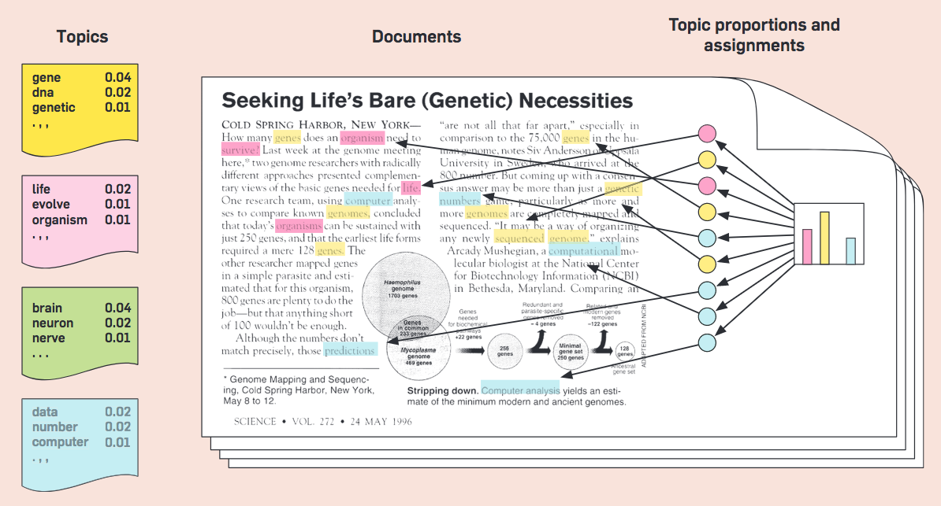
Topic Modeling of a Science Article

Slide 24
Topic Modeling
Common topic modeling algorithms include Latent Semantic Analysis (LSA), Probablistic Latent Sentiment Analysis (PLSA), and Latent Dirichlet allocation (LDA).
LDA is an example of unsupervised machine learning. This means that while you configure in broad terms how you would like the algorithm to proceed (e.g. select the number of topics you think exist ahead of time), the algorithm successfully produces topics without any additional input on your part.
(You will likely want to fiddle with the number of topics based on human-readibility or diagnostic tools to get as close possible to the “true number” of topics, however!)

Slide 25
jsLDA!

Slide 26
Other Types of Machine Learning for Text Analysis
Classification (beyond sentiment analysis)
Clustering
…

